Slide 1
TechCorp’s IAM Platform Implementation Project Plan
Rohini Ravikumar rohinizz96@gmail.com https://www.linkedin.com/in/rrrohini/
Notes:
1

Slide 2
agenda
1. Project Overview
2. Implementation Approach
3. Key Milestones & Timelines
4. Resource Requirements
5. Risk Management & Mitigation
6. Testing & Validation
7. Training & Change Management
8. Post-Implementation Support & Monitoring
9. Next Steps
Notes:
2

Slide 3

Project Overview
Notes:
3

Slide 4
Objective:
Implement an Identity and Access Management (IAM) platform that enhances User Lifecycle Management and Access Control Mechanisms to strengthen security, improve operational efficiency, and align with TechCorp’s digital transformation strategy.
Scope:
Automate user provisioning and de-provisioning
Enforce multi-factor authentication (MFA)
Strengthen privileged access management (PAM)
Align IAM with compliance & governance
Success Criteria:
Secure, seamless, and scalable IAM deployment
Minimal disruption to TechCorp’s daily operations
Notes:
Jhkk
‹#›

Slide 5
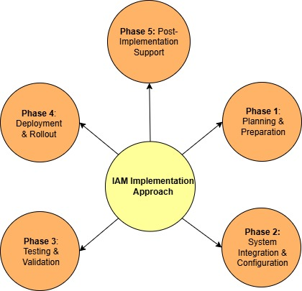
Implementation Approaches
A structured, phased approach ensures a seamless IAM platform deployment while minimizing disruptions to TechCorp’s operations.
4
Notes:
4

Slide 6
Phase 1: Planning & Preparation.
Define business & security requirements for IAM integration
Identify key stakeholders (IT, HR, Security, Compliance, Business Units)
Assess current infrastructure readiness and integration points
Develop a project roadmap with milestones, timelines, and dependencies
Phase 2: System Integration & Configuration.
Deploy IAM platform (Okta, Microsoft Entra ID, or SailPoint)
Configure Role-Based Access Control (RBAC) and user identity policies
Integrate IAM with HRMS (Workday, SAP SuccessFactors), IT systems, and cloud environments
Implement Multi-Factor Authentication (MFA) and Privileged Access Management (PAM)
5
Notes:
5

Slide 7
Phase 3: Testing & Validation
Conduct unit testing for individual IAM components
Perform integration testing with HR, IT, and cloud services
Run User Acceptance Testing (UAT) to ensure seamless authentication and access management
Validate security & compliance requirements, including access control policies and audit logging
Phase 4: Deployment & Rollout
Pilot Deployment: Implement
IAM for a small group of users to gather feedback
Phased Rollout: Gradual expansion across business units to minimize risk
Full Deployment: Organization-wide IAM adoption with monitoring and support
‹#›

Slide 8
Phase 5: Post-Implementation Support & Monitoring
Continuous real-time monitoring for anomalies and security threats
Implement incident response procedures for IAM-related security events
Conduct regular access reviews & compliance audits
Optimize IAM policies based on user feedback and evolving security needs
‹#›

Slide 9
Key Milestones & Timelines
Milestones | Timeline
IAM Project Kickoff | Week 1
Infrastructure Readiness Assessment | Weeks 2-3
IAM Platform Deployment & Configuration | Weeks 4-6
Role-Based Access Control (RBAC) Setup | Weeks 7-8
User Lifecycle Management Automation | Weeks 9-10
Testing & Security Validation | Weeks 11-12
Pilot Deployment | Weeks 13-14
Organization-Wide Rollout | Weeks 15-18
Post-Implementation Monitoring | Ongoing (Week 19+)

Slide 10

Resource Requirements
‹#›

Slide 11
Personnel:
IAM Specialists (Architects, Developers, Engineers)
Security & Compliance Experts
IT Operations & Support Team
HR & Business Process Owners.
Technical Resources:
IAM Solution (Okta, SailPoint, Microsoft Entra ID)
Cloud Infrastructure & Integration Tools
Logging & Monitoring Systems (Splunk, QRadar)
Budget Considerations:
Licensing & Subscription Fees
Hardware & Software Costs
Training & Change Management Expenses
‹#›

Slide 12
Risk Management & Mitigation
‹#›

Slide 13
Potential Risks & Solutions:
Integration Challenges → Conduct pre-implementation testing & phased rollout
User Resistance to Change → Provide early communication & comprehensive training
Security Misconfigurations → Implement rigorous testing & compliance validation
Downtime During Deployment → Plan for off-peak deployment & rollback mechanisms
‹#›

Slide 14
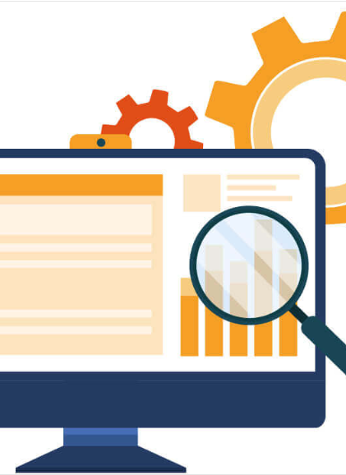
Testing & Validation

Slide 15
Testing Phases:
Unit Testing – Validate individual IAM components
Integration Testing – Ensure seamless connectivity with HRMS, IT, and cloud systems
User Acceptance Testing (UAT) – Conduct real-world testing with key user groups
Security & Compliance Testing – Validate MFA, PAM, and Zero Trust policies
Success Metrics:
100% role-based access compliance
No unauthorized access detected during penetration tests
Seamless authentication & authorization experience
‹#›

Slide 16

Training & Change Management

Slide 17
Training Approach:
End-User Training: Self-service access management, MFA authentication
IT & Security Team Training: IAM administration, incident response
Leadership Awareness Sessions: Strategic IAM benefits & compliance impact
Communication Strategy:
Stakeholder briefings & Q&A sessions
Internal knowledge base & help desk support
Feedback collection & iterative improvements
‹#›

Slide 18

Post-Implementation Support & Monitoring

Slide 19
Continuous Performance Monitoring:
Use SIEM tools (Splunk, IBM QRadar) for security event monitoring
Real-time alerts on authentication failures & access anomalies
Incident Response & Troubleshooting:
Define escalation procedures for IAM-related incidents
Conduct post-implementation audits & fine-tune policies
Ongoing Enhancements:
Regularly update IAM policies based on business changes
Integrate new security features as IAM technologies evolve
‹#›

Slide 20
Next Steps
Finalize stakeholder approvals & project kick-off.
Conduct initial infrastructure assessment
Establish implementation roadmap & assign resources
Initiate first phase (IAM platform configuration & integration)
Set up governance & monitoring framework for sustained security
‹#›

Slide 21
thank you
Rohini Ravikumar
  rohinizz96@gmail.com
  https://www.linkedin.com/in/rrrohini/
Notes:
13

